Slide 1
Computing Gradient
Hung-yi Lee
李宏毅
Notes:
https://medium.com/@aidangomez/let-s-do-this-f9b699de31d9#.n6l28c26g

Slide 2
Introduction
Backpropagation: an efficient way to compute the gradient
Prerequisite
Backpropagation for feedforward net:
http://speech.ee.ntu.edu.tw/~tlkagk/courses/MLDS_2015_2/Lecture/DNN%20backprop.ecm.mp4/index.html
Simple version: https://www.youtube.com/watch?v=ibJpTrp5mcE
Backpropagation through time for RNN: http://speech.ee.ntu.edu.tw/~tlkagk/courses/MLDS_2015_2/Lecture/RNN%20training%20(v6).ecm.mp4/index.html
Understanding backpropagation by computational graph
Tensorflow, Theano, CNTK, etc.
Notes:
Backpropagation through time: http://speech.ee.ntu.edu.tw/~tlkagk/courses/MLDS_2015_2/Lecture/RNN%20training%20(v6).ecm.mp4/index.html

Slide 3
Computational Graph

Slide 4

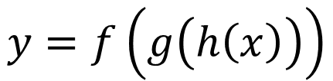







Computational Graph
$$a=f\left(b,c\right)$$
b
$$f$$
a
A “language” describing a function
Node: variable (scalar, vector, tensor ……)
Edge: operation (simple function)
c
Example
$$y=f\left(g\left(h\left(x\right)\right)\right)$$
$$u=h\left(x\right)$$
$$v=g\left(u\right)$$
$$y=f\left(v\right)$$
x
u
v
y
$$h$$
$$g$$
$$f$$

Slide 5
Computational Graph
Example: e = (a+b) ∗ (b+1)
c = a + b
e
6
d = b + 1
∗
e = c ∗ d
c
d
3
2
+1
+
a
b
2
1

Slide 6
Review: Chain Rule
Case 1
g
h
x
y
z
Case 2
x
s
z
y

Slide 7



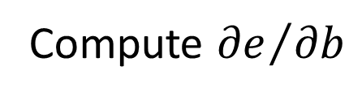


Computational Graph
Example: e = (a+b) ∗ (b+1)
Compute ${∂e}/{∂b}$
e
=1x(b+1)+1x(a+b)
$$\frac{∂e}{∂c}$$
∗
$$\frac{∂e}{∂d}$$
Sum over all paths from b to e
=d
=c
=a+b
c
=b+1
d
+1
$$\frac{∂c}{∂a}$$
+
$$\frac{∂c}{∂b}$$
$$\frac{∂d}{∂b}$$
=1
=1
=1
a
b

Slide 8





e=<a+b,d+1>
e
$$\frac{∂e}{∂c}$$
$$\frac{∂e}{∂d}$$
<,>
c
d
$$\frac{∂c}{∂a}$$
$$\frac{∂c}{∂b}$$
$$\frac{∂d}{∂b}$$
+[1,1,1]
+
a
=[2,1,0]
b
=[1,2,3]

Slide 9





e=<a+b,d+1>
e
$$ge_c$$
<,>
$$ge_d$$
c
d
$$gc_a$$
$$gc_b$$
$$gd_b$$
+[1,1,1]
+
a
=[2,1,0]
b
=[1,2,3]

Slide 10





$$gb_a$$
$$gc_b$$
a
b
c
$$gb_a2$$
$gb_a$ $=tf.gradients(b,a)$
$gc_b$ $=tf.gradients(c,b)$
$gb_a2$ $=tf.gradients(b,a,gc_b)$
Then
$gb_a2$ $=gc_b$ $∗gb_a$

Slide 11
flatten
w₀z₀+b₀
relu
w₁z₁+b₁
relu
w₂z₂+b₂
x
z₀
y₀
z₁
y₁
z₂
y₂
w₀
w₁
w₂
b₀
b₁
b₂
relu
w₃z₃+b₃
z₃
logits
cross
entropy
loss
softmax cross entropy
reduced
mean
w₃
b₃

Slide 12
x
z₀
y₀
z₁
y₁
z₂
y₂
w₀
w₁
w₂
b₀
b₁
b₂
gll
z₃
logits
cross
entropy
loss
w₃
b₃

Slide 13
x
z₀
y₀
z₁
y₁
z₂
y₂
w₀
w₁
w₂
b₀
b₁
b₂
glw3
z₃
logits
cross
entropy
loss
w₃
b₃

Slide 14
x
z₀
y₀
z₁
y₁
z₂
y₂
w₀
w₁
w₂
b₀
b₁
b₂
z₃
logits
cross
entropy
loss
w₃
glb3
b₃

Slide 15
x
z₀
y₀
z₁
y₁
z₂
y2
w₀
w₁
w₂
b₀
b₁
b₂
gly2
z₃
logits
cross
entropy
loss
w₃
b₃

Slide 16
gy2w2
x
z₀
y₀
z₁
y₁
z₂
y2
w₀
w₁
w₂
b₀
b₁
b₂
z₃
logits
cross
entropy
loss
w₃
b₃

Slide 17
gy2b2
x
z₀
y₀
z₁
y₁
z₂
y2
w₀
w₁
w₂
b₀
b₁
b₂
z₃
logits
cross
entropy
loss
w₃
b₃

Slide 18
gy2y1
x
z₀
y₀
z₁
y1
z₂
y2
w₀
w₁
w₂
b₀
b₁
b₂
z₃
logits
cross
entropy
loss
w₃
b₃

Slide 19
gy1w1
x
z₀
y₀
z₁
y1
z₂
y2
w₀
w₁
w₂
b₀
b₁
b₂
z₃
logits
cross
entropy
loss
w₃
b₃

Slide 20
gy1b1
x
z₀
y₀
z₁
y1
z₂
y2
w₀
w₁
w₂
b₀
b₁
b₂
z₃
logits
cross
entropy
loss
w₃
b₃

Slide 21
gy1y0
x
z₀
y0
z₁
y1
z₂
y2
w₀
w₁
w₂
b₀
b₁
b₂
z₃
logits
cross
entropy
loss
w₃
b₃

Slide 22
gy0w0
x
z₀
y0
z₁
y1
z₂
y2
w₀
w₁
w₂
b₀
b₁
b₂
z₃
logits
cross
entropy
loss
w₃
b₃

Slide 23
gy0b0
x
z₀
y0
z₁
y1
z₂
y2
w₀
w₁
w₂
b₀
b₁
b₂
z₃
logits
cross
entropy
loss
w₃
b₃

Slide 24
Computational Graph
Example: e = (a+b) ∗ (b+1)
Compute ${∂e}/{∂b}$
e
15
a = 3, b = 2
$$\frac{∂e}{∂c}$$
$$\frac{∂e}{∂d}$$
∗
=d
=c
3
5
c
d
5
3
+1
$$\frac{∂c}{∂a}$$
+
$$\frac{∂c}{∂b}$$
$$\frac{∂d}{∂b}$$
=1
=1
=1
a
b
3
2

Slide 25
Computational Graph
Example: e = (a+b) ∗ (b+1)
Compute ${∂e}/{∂b}$
Compute ${∂e}/{∂b}$
=8
e
8
a = 3, b = 2
$$\frac{∂e}{∂c}$$
$$\frac{∂e}{∂d}$$
∗
=d
=c
3
5
c
d
1
1
+1
$$\frac{∂c}{∂a}$$
+
$$\frac{∂c}{∂b}$$
$$\frac{∂d}{∂b}$$
=1
=1
=1
a
b
1
Start with 1

Slide 26
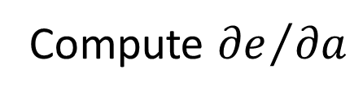
Computational Graph
Example: e = (a+b) ∗ (b+1)
Compute ${∂e}/{∂a}$
=3
e
3
a = 3, b = 2
$$\frac{∂e}{∂c}$$
$$\frac{∂e}{∂d}$$
∗
=d
=c
3
5
c
d
1
+1
$$\frac{∂c}{∂a}$$
+
$$\frac{∂c}{∂b}$$
$$\frac{∂d}{∂b}$$
=1
=1
=1
a
b
1
Start with 1

Slide 27
Computational Graph
Reverse mode
What is the benefit?
Example: e = (a+b) ∗ (b+1)
e
Start with 1
Compute
and
1
$$\frac{∂e}{∂c}$$
∗
$$\frac{∂e}{∂d}$$
=d
=c
a = 3, b = 2
3
5
c
d
3
5
+1
$$\frac{∂c}{∂a}$$
+
$$\frac{∂c}{∂b}$$
$$\frac{∂d}{∂b}$$
=1
=1
=1
a
b
3
8

Slide 28













Computational Graph
Parameter sharing: the same parameters appearing in different nodes
$$\frac{∂y}{∂x}=?$$
$$y=xe^{x^{2}}$$
$$e^{x^{2}}+x∙e^{x^{2}}∙2x$$
$$\frac{∂y}{∂x}=x∙e^{x^{2}}∙x$$
x
$$x$$
u
exp
$$x$$
∗
v
$$u$$
∗
y
$$\frac{∂y}{∂x}=x∙e^{x^{2}}∙x$$
$$=e^{x^{2}}$$
x
$$x$$
x
$$u$$
$$=e^{x^{2}}$$
$$\frac{∂y}{∂x}=e^{x^{2}}$$

Slide 29
Computational Graph for Feedforward Net

Slide 30
Review: Backpropagation
Error signal
Layer
Layer
Forward Pass
Backward Pass
…
…
…
…

Slide 31
Review: Backpropagation
Layer L-1
Layer L
Error signal
……
……
Backward Pass
…
…
……
…
…
(we do not use softmax here)

Slide 32





Feedforward Network
y
W^{L}
…
W²
W¹
x
b¹
b²
…
b^{L}
+
+
+
$$σ\left( \right)$$
$$=σ\left( \right)$$
$$σ\left( \right)$$
$$z^{1}=W^{1}x+b^{1}$$
$$z^{2}=W^{2}a^{1}+b^{2}$$
x
z¹
a¹
z²
y
$$σ$$
$$σ$$
W¹
W²
b¹
b²

Slide 33

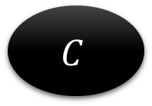
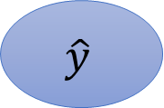
Loss Function of Feedforward Network
$$C=L\left(y,\hat{y} \right)$$
$$\hat{y}$$
$$C$$
$$z^{1}=W^{1}x+b^{1}$$
$$z^{2}=W^{2}a^{1}+b^{2}$$
x
z¹
a¹
z²
y
$$σ$$
$$σ$$
W¹
W²
b¹
b²

Slide 34



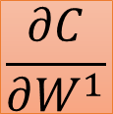
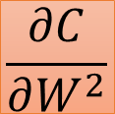
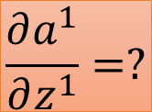
Gradient of Cost Function
$$C=L\left(y,\hat{y} \right)$$
To compute the gradient …
$$\hat{y}$$
$$C$$
Computing the partial derivative on the edge
Using reverse mode
Output is always a scalar
x
z¹
a¹
z²
y
$$σ$$
$$σ$$
$$\frac{∂C}{∂W^{1}}$$
W¹
$$\frac{∂C}{∂W^{2}}$$
W²
vector
$$\frac{∂a^{1}}{∂z^{1}}=?$$
$$\frac{∂C}{∂b^{1}}$$
b¹
$$\frac{∂C}{∂b^{2}}$$
b²
vector

Slide 35
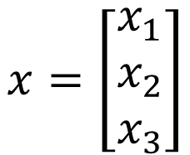
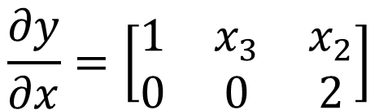

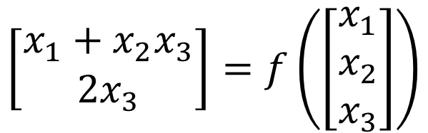
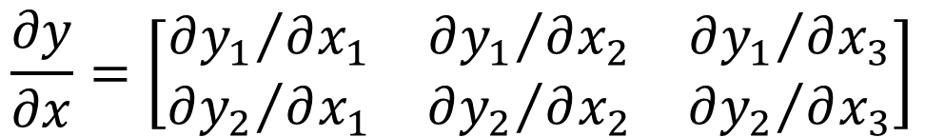
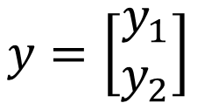
Jacobian Matrix
$$x=\left[\begin{aligned}x_{1} \\ x_{2} \\ x_{3}\end{aligned}\right]$$
$$y=\left[\begin{aligned}y_{1} \\ y_{2}\end{aligned}\right]$$
$$y=f\left(x\right)$$
$$\frac{∂y}{∂x}=\left[\begin{matrix}{∂y_{1}}/{∂x_{1}} & {∂y_{1}}/{∂x_{2}} & {∂y_{1}}/{∂x_{3}} \\ {∂y_{2}}/{∂x_{1}} & {∂y_{2}}/{∂x_{2}} & {∂y_{2}}/{∂x_{3}}\end{matrix}\right]$$
size of y
Example
size of x
$$\left[\begin{aligned}x_{1}+x_{2}x_{3} \\ 2x_{3}\end{aligned}\right]=f\left(\left[\begin{aligned}x_{1} \\ x_{2} \\ x_{3}\end{aligned}\right]\right)$$
$$\frac{∂y}{∂x}=\left[\begin{matrix}1 & x_{3} & x_{2} \\ 0 & 0 & 2\end{matrix}\right]$$

Slide 36


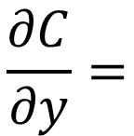
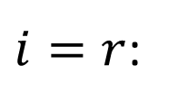



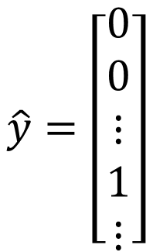
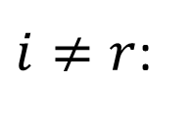
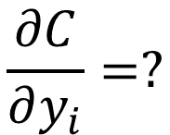
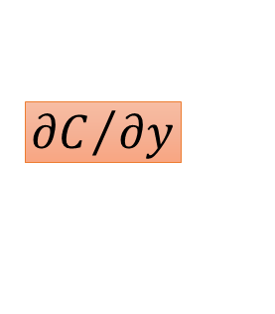
Gradient of Cost Function
$$C=L\left(y,\hat{y} \right)$$
$$\hat{y}$$
$$C$$
$$\hat{y}=\left[\begin{aligned}0 \\ 0 \\ ⋮ \\ 1 \\ ⋮\end{aligned}\right]$$
Last Layer
$${∂C}/{∂y}$$
…
…
$$r$$
y
$$\frac{∂C}{∂y_{i}}=?$$
…
…
Cross Entropy:
$$C=−logy_{r}$$
$i=r$:
$$\frac{∂C}{∂y}=$$
$${∂C}/{∂y_{r}}=−1/y_{r}$$
$$\left[\begin{matrix}\begin{matrix}0 & ⋯\end{matrix} & \begin{matrix}−1/y_{r} & ⋯\end{matrix}\end{matrix}\right]$$
$i≠r$:
$${∂C}/{∂y_{i}}=0$$
Notes:
Only one dimension is 1, and others are all 0
Index of the dimension which is 1
Do we have to consider other dimensions?

Slide 37
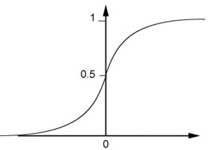
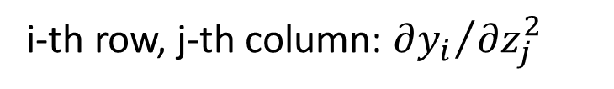




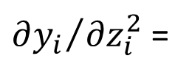

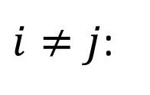

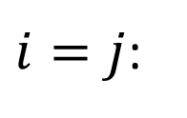



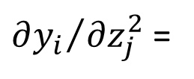


Gradient of Cost Function
square
$$C=L\left(y,\hat{y} \right)$$
$$\frac{∂y}{∂z^{2}}$$
$$y$$
is a Jacobian matrix
$$\hat{y}$$
$$C$$
$$z^{2}$$
i-th row, j-th column: ${∂y_{i}}/{∂z_{j}^{2}}$
$${∂C}/{∂y}$$
$$\frac{∂y}{∂z^{2}}$$
$i≠j$:
${∂y_{i}}/{∂z_{j}^{2}}$ =
z²
y
$i=j$:
${∂y_{i}}/{∂z_{i}^{2}}$ =
$$σ′\left(z_{i}^{2}\right)$$
$$σ$$
$$y_{i}=σ\left(z_{i}^{2}\right)$$
$$y$$
$$σ′\left(z_{i}^{2}\right)$$
How about softmax? ☺
Diagonal
Matrix
$$z_{i}^{2}$$
$$z$$

Slide 38










$$\frac{∂z^{2}}{∂a^{1}}$$
is a Jacobian matrix
$$a^{1}$$
$$z^{2}$$
$$C=L\left(y,\hat{y} \right)$$
i-th row, j-th column:
$$\hat{y}$$
$$C$$
$$\frac{∂z_{i}^{2}}{∂a_{j}^{1}}=W_{ij}^{2}$$
$${∂C}/{∂y}$$
$$z^{2}=W^{2}a^{1}$$
$$\frac{∂y}{∂z^{2}}$$
$$\frac{∂z^{2}}{∂a^{1}}$$
$$z_{i}^{2}=w_{i1}^{2}a_{1}^{1}+w_{i2}^{2}a_{2}^{1}+$$
a¹
z²
y
$$σ$$
$$⋯+w_{in}^{2}a_{n}^{1}$$
$$\frac{∂z^{2}}{∂W^{2}}$$
W²
$$W^{2}$$

Slide 39

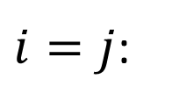
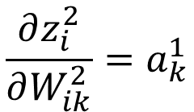
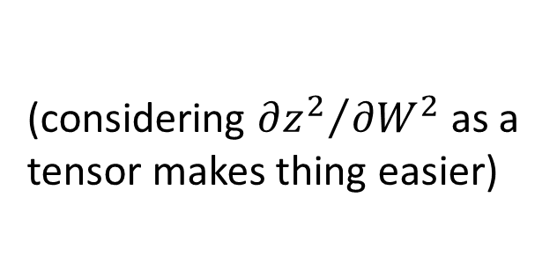
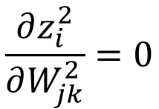

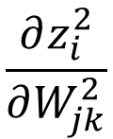
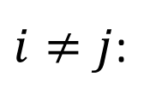
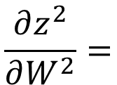
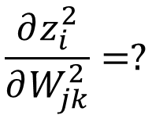
mxn
$$\frac{∂z_{i}^{2}}{∂W_{jk}^{2}}$$
$$\frac{∂z^{2}}{∂W^{2}}=$$
(j-1)xn+k
m
i
$$C=L\left(y,\hat{y} \right)$$
$$\frac{∂z_{i}^{2}}{∂W_{jk}^{2}}=?$$
$$\frac{∂z_{i}^{2}}{∂W_{jk}^{2}}=0$$
$$\hat{y}$$
$$C$$
$i≠j$:
$$\frac{∂z_{i}^{2}}{∂W_{ik}^{2}}=a_{k}^{1}$$
$${∂C}/{∂y}$$
$i=j$:
$$z^{2}=W^{2}a^{1}$$
$$\frac{∂y}{∂z^{2}}$$
$$z_{i}^{2}=w_{i1}^{2}a_{1}^{1}+w_{i2}^{2}a_{2}^{1}+$$
a¹
$$W^{2}$$
z²
y
$$σ$$
$$⋯+w_{in}^{2}a_{n}^{1}$$
n
m
$$\frac{∂z^{2}}{∂W^{2}}$$
W²
Considering W² as a mxn vector
mxn
(considering ${∂z^{2}}/{∂W^{2}}$ as a tensor makes thing easier)

Slide 40










mxn
$$\frac{∂z_{i}^{2}}{∂W_{jk}^{2}}$$
$$\frac{∂z^{2}}{∂W^{2}}=$$
(j-1)xn+k
m
i
$$C=L\left(y,\hat{y} \right)$$
$$\frac{∂z_{i}^{2}}{∂W_{jk}^{2}}=?$$
$$\frac{∂z_{i}^{2}}{∂W_{jk}^{2}}=0$$
$$\hat{y}$$
$$C$$
$i≠j$:
$$\frac{∂z_{i}^{2}}{∂W_{ik}^{2}}=a_{k}^{1}$$
$${∂C}/{∂y}$$
$i=j$:
$$z^{2}=W^{2}a^{1}$$
$$\frac{∂y}{∂z^{2}}$$
$$j=1$$
$$j=2$$
$$j=3$$
a¹
$$W^{2}$$
z²
y
$$σ$$
i=1
n
m
$$a$$
$$\frac{∂z^{2}}{∂W^{2}}$$
$$0$$
$$a$$
i=2
W²
Considering W² as a mxn vector
$$m$$
$$a$$
mxn
$$0$$
$$m×n$$

Slide 41
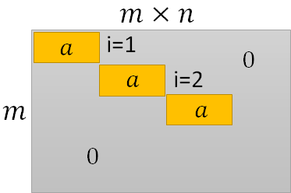
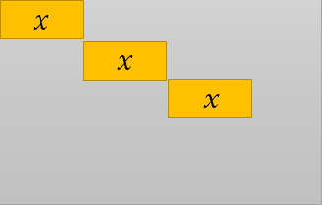
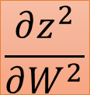
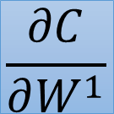


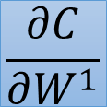
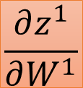
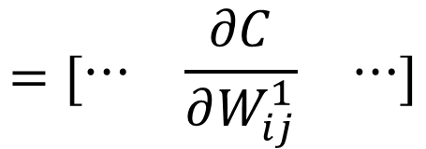

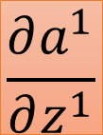

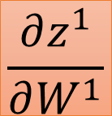

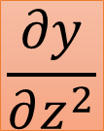

$$\frac{∂C}{∂W^{1}}$$
$$\frac{∂C}{∂y}$$
$$\frac{∂y}{∂z^{2}}$$
$$\frac{∂a^{1}}{∂z^{1}}$$
$$\frac{∂z^{1}}{∂W^{1}}$$
$$=[\begin{matrix}⋯ & \frac{∂C}{∂W_{ij}^{1}} & ⋯\end{matrix}]$$
$$=$$
$$W^{2}$$
$$C=L\left(y,\hat{y} \right)$$
$$\hat{y}$$
$$C$$
$${∂C}/{∂y}$$
$$\frac{∂a^{1}}{∂z^{1}}$$
$$\frac{∂y}{∂z^{2}}$$
$$W^{1}$$
$$W^{2}$$
x
z¹
a¹
z²
y
$$σ$$
$$σ$$
$$\frac{∂z^{1}}{∂W^{1}}$$
$$\frac{∂z^{2}}{∂W^{2}}$$
W¹
W²
$$\frac{∂C}{∂W^{1}}$$

Slide 42


Question
Q: Only backward pass for computational graph?
Q: Do we get the same results from the two different approaches?

Slide 43
Computational Graph for Recurrent Network

Slide 44
















v1
v2
$$v1=\frac{e1}{N}$$
$$v2=\frac{e2}{N}$$
$$\frac{∂v1}{∂N}$$
$$\frac{∂v2}{∂N}$$
/
/
$$N=e1+e2$$
$$\frac{∂v1}{∂e1}$$
N
$$\frac{∂v2}{∂e2}$$
$$e1=ez1$$
$$e2=ez2$$
+
$$\frac{∂N}{∂e1}$$
$$\frac{∂N}{∂e2}$$
e1
e2
$$\frac{∂v1}{∂z1}$$
$$=$$
$$?$$
$$\frac{∂e1}{∂z1}$$
$$\frac{∂e2}{∂z2}$$
exp
exp
z1
z2

Slide 45
J_{MMI}
MMI Loss Function
…
V_{t-1}^{L}
V_{t}^{L}
V_{t+1}^{L}
…
softmax
softmax
softmax
AM
AM
AM
Z_{t-1}^{L}
Z_{t}^{L}
Z_{t+1}^{L}
…
…
…
…
…
…
Z_{t-1}⁰
Z_{t}⁰
Z_{t+1}⁰
…
=O_{t-1}
=O_{t}
=O_{t+1}

Slide 46
J_{MMI}
MMI Loss Function
e_{t}^{L}
…
V_{t-1}^{L}
V_{t}^{L}
V_{t+1}^{L}
…
softmax
softmax
softmax
AM
AM
AM
Z_{t-1}^{L}
Z_{t}^{L}
Z_{t+1}^{L}
…
…
…
∂z_{t}^{L}/∂θ
…
…
…
Z_{t-1}⁰
Z_{t}⁰
Z_{t+1}⁰
…
=O_{t-1}
=O_{t}
=O_{t+1}

Slide 47
v1
v2
$$v1=\frac{e1}{N}$$
$$v2=\frac{e2}{N}$$
$$\frac{∂v1}{∂N}$$
$$\frac{∂v2}{∂N}$$
/
/
$$N=e1+e2$$
$$\frac{∂v1}{∂e1}$$
N
$$\frac{∂v2}{∂e2}$$
$$e1=ez1$$
$$e2=ez2$$
+
$$\frac{∂N}{∂e1}$$
$$\frac{∂N}{∂e2}$$
e1
e2
$$\frac{∂v1}{∂z1}$$
$$=$$
$$?$$
$$\frac{∂e1}{∂z1}$$
$$\frac{∂e2}{∂z2}$$
exp
exp
z1
z2

Slide 48







v1
v2
$$v1=\frac{e1}{N}$$
$$v2=\frac{e2}{N}$$
$$\frac{∂v1}{∂N}$$
$$\frac{∂v2}{∂N}$$
/
/
$$N=e1+e2$$
$$\frac{∂v1}{∂e1}$$
N
$$\frac{∂v2}{∂e2}$$
$$e1=ez1$$
$$e2=ez2$$
+
$$\frac{∂N}{∂e1}$$
$$\frac{∂N}{∂e2}$$
e1
e2
$$\frac{∂v1}{∂z1}$$
$$=$$
$$\frac{∂e1}{∂z1}$$
$$\frac{∂e2}{∂z2}$$
exp
exp
$$\frac{∂v1}{∂e1}$$
$$\frac{∂v1}{∂N}$$
$$\frac{∂N}{∂e1}$$
$$\frac{∂e1}{∂z1}$$
$$+$$
$$∗$$
$$∗$$
z1
z2

Slide 49


Recurrent Network
y¹
y²
y³
h⁰
f
h¹
f
h²
f
h³
……
x¹
x²
x³
$$y^{t},h^{t}=f\left(x^{t},h^{t−1};W^{i},W^{h},W^{o}\right)$$
$$h^{t}=σ\left(W^{i}x^{t}+W^{h}h^{t−1}\right)$$
$$y^{t}=softmax\left(W^{o}h^{t}\right)$$
(biases are ignored here)

Slide 50








Recurrent Network
$$y^{t},h^{t}=f\left(x^{t},h^{t−1};W^{i},W^{h},W^{o}\right)$$
$$a^{t}=σ\left(W^{i}x^{t}+W^{h}h^{t−1}\right)$$
$$y^{t}=softmax\left(W^{o}h^{t}\right)$$
Wº
o¹
y¹
$$×$$
$$softmax$$
a⁰
m¹
z¹
h¹
$$×$$
$$+$$
$$σ$$
W^{h}
n¹
$$×$$
x¹
W^{i}

Slide 51


Recurrent Network
$$y^{t},h^{t}=f\left(x^{t},h^{t−1};W^{i},W^{h},W^{o}\right)$$
$$a^{t}=σ\left(W^{i}x^{t}+W^{h}h^{t−1}\right)$$
$$y^{t}=softmax\left(W^{o}h^{t}\right)$$
Wº
y¹
$$y^{t}=softmax\left(W^{o}h^{t}\right)$$
h⁰
h¹
W^{h}
$$h^{t}=σ\left(W^{i}x^{t}+W^{h}h^{t−1}\right)$$
x¹
W^{i}

Slide 52




Recurrent Network
$$C=C^{1}+C^{2}+C^{3}$$
C
$${\hat{y}}^{1}$$
C¹
$${\hat{y}}^{2}$$
C²
$${\hat{y}}^{3}$$
C³
Wº
y¹
Wº
y²
Wº
y³
h⁰
h¹
h²
h³
W^{h}
W^{h}
W^{h}
x¹
W^{i}
x²
W^{i}
x³
W^{i}

Slide 53














Recurrent Network
$$C=C^{1}+C^{2}+C^{3}$$
C
1
1
1
$${\hat{y}}^{1}$$
C¹
$${\hat{y}}^{2}$$
C²
$${\hat{y}}^{3}$$
C³
$${∂C^{1}}/{∂y^{1}}$$
$${∂C^{2}}/{∂y^{2}}$$
$${∂C^{3}}/{∂y^{3}}$$
Wº
y¹
Wº
y²
Wº
y³
$${∂y^{1}}/{∂h^{1}}$$
$${∂y^{2}}/{∂h^{2}}$$
$${∂y^{3}}/{∂h^{3}}$$
h⁰
h¹
$${∂h^{2}}/{∂h^{1}}$$
h²
$${∂h^{3}}/{∂h^{2}}$$
h³
W^{h}
$${∂h^{1}}/{∂W^{h}}$$
W^{h}
$${∂h^{2}}/{∂W^{h}}$$
W^{h}
$${∂h^{3}}/{∂W^{h}}$$
$$\frac{∂C}{∂W^{h}}$$
$$\frac{∂C}{∂W^{h}}$$
$$\frac{∂C}{∂W^{h}}$$
x¹
W^{i}
x²
W^{i}
x³
W^{i}

Slide 54

















$$\frac{∂C}{∂W^{h}}$$
$$\frac{∂C^{1}}{∂y^{1}}\frac{∂y^{1}}{∂h^{1}}$$
$$\frac{∂C^{2}}{∂y^{2}}\frac{∂y^{2}}{∂h^{2}}\frac{∂h^{2}}{∂h^{1}}$$
$$\frac{∂C^{3}}{∂y^{3}}\frac{∂y^{3}}{∂h^{3}}\frac{∂h^{3}}{∂h^{2}}\frac{∂h^{2}}{∂h^{1}}$$
$$\frac{∂h^{1}}{∂W^{h}}$$
1
$$=$$
+
+
$$\frac{∂C}{∂W^{h}}$$
$$\frac{∂C}{∂W^{h}}$$
$$\frac{∂C}{∂W^{h}}$$
$$\frac{∂C}{∂W^{h}}$$
$$\frac{∂C}{∂W^{h}}$$
2
$$= ……$$
$$=$$
1
$$+$$
2
$$+$$
3
$$\frac{∂C}{∂W^{h}}$$
3
$$= ……$$
1
2
3

Slide 55
Reference
Textbook: Deep Learning
Chapter 6.5
Calculus on Computational Graphs: Backpropagation
https://colah.github.io/posts/2015-08-Backprop/
On chain rule, computational graphs, and backpropagation
http://outlace.com/Computational-Graph/
Notes:
Review backpropagation???

Slide 56
Acknowledgement
感謝 翁丞世 同學找到投影片上的錯誤

